Slide 1
Chapter 12 Supervised Learning
Modern Statistics For Modern Biology
Presenter: Hyejeong Ryu

Slide 2
12.0 Intro
Unsupervised Learning: Chapter 5, 7, 9 - Clustering, Multivariate analysis
Supervised Learning vs Unsupervised Learning
Dog
Cat
Dog
Cat
Dog
Cat

Slide 3
12.0 Intro
Unsupervised Learning: Chapter 5, 7, 9 - Clustering, Multivariate analysis
Supervised Learning vs Unsupervised Learning

Slide 4
12.1 Goals for this chapter
See exemplary applications that motivate the use of supervised learning methods.
Learn what discriminant analysis does.
Define measures of performance.
Encounter the curse of dimensionality and see what overfitting is.
Find out about regularization – in particular, penalization – and understand the concepts of generalizability and model complexity.
See how to use cross-validation to tune parameters of algorithms.
Discuss method hacking.

Slide 5
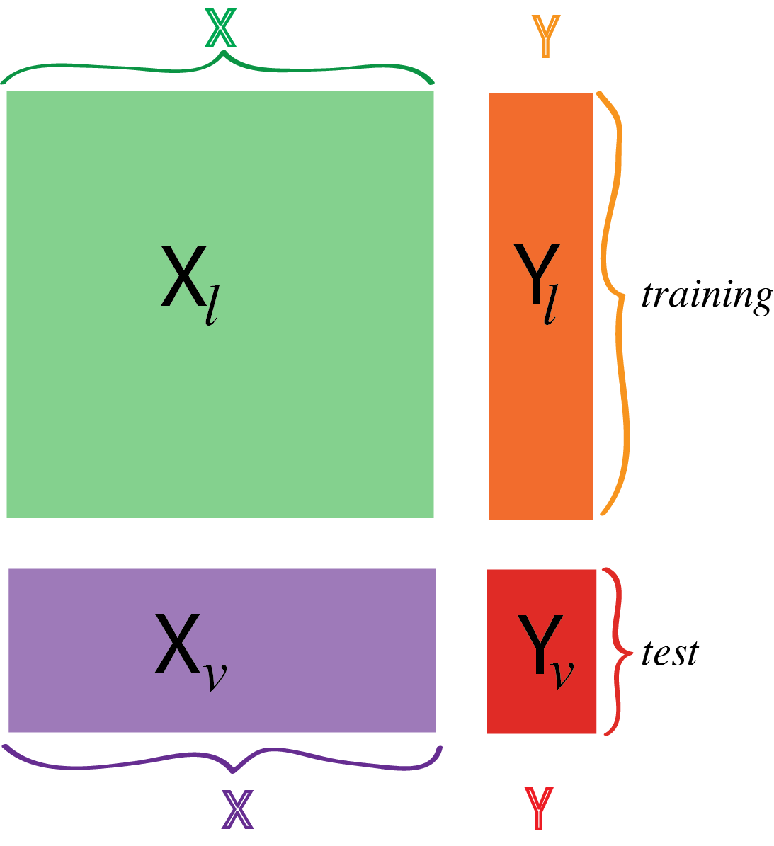
12.2 What are the data?
Basic data structure for both supervised and unsupervised learning: dataframe
Supervised learning tries to find a mathematical function or a computational algorithm that predicts the value of one of the features from the other features.
Supervised learning can cover continuous(regression) and categorical(classification) response(objective) variables.
X: explanatory variables
Y: response(objective) variables

Slide 6
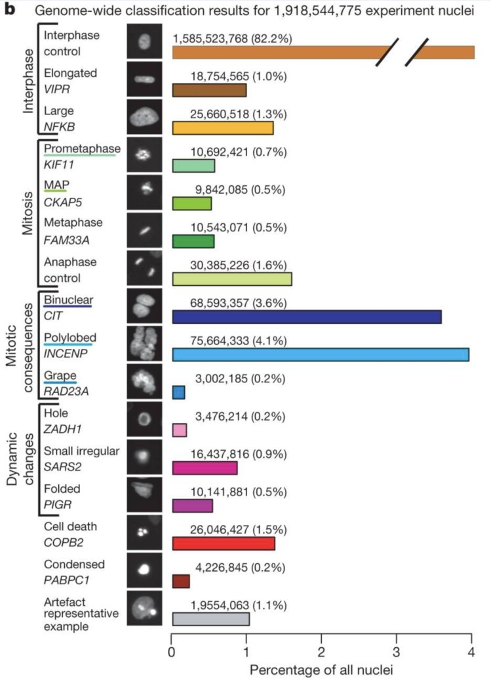
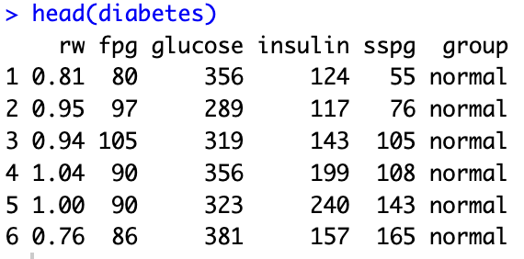
12.2.1 Motivating examples
Predicting diabetes type rw: relative weight fpg: fasting plasma glucose glucose: area under plasma glucose curve for the three hour oral glucose tolerance test insulin: area under the plasma insulin curve for the OGTT sspg: steady state plasma glucose response group: normal, chemical diabetes and overt diabetes
Predicting cellular phenotypes
Predicting embryonic cell states prediction of cell state, genotype from gene expression measurements

Slide 7
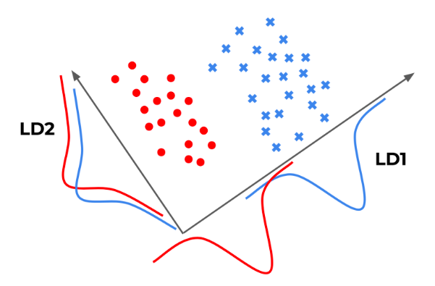
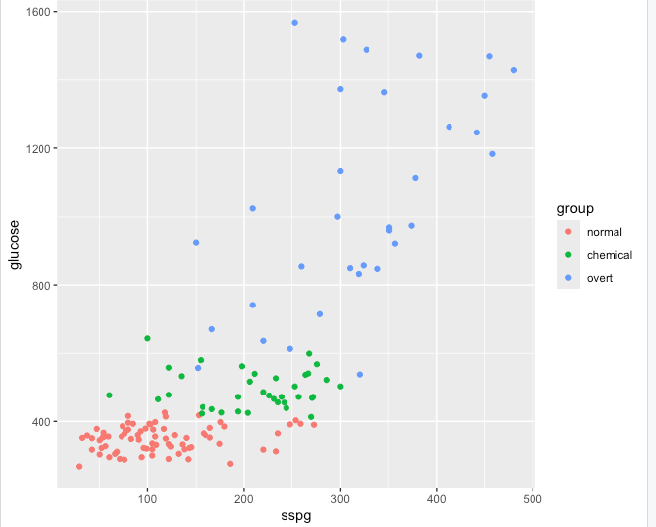
12.3 Linear discrimination
Objects described by two continuous features, falling into three groups.
Aim is to define class boundaries.
12.3.1 Diabetes data
Predicting group from sspg and glucose variables.

Slide 8
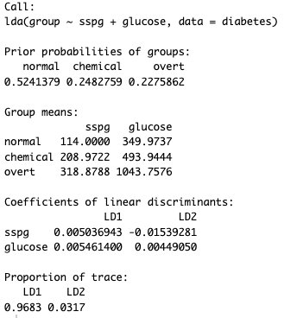
12.3.1 Diabetes data
Starting with a method called linear discriminant analysis(LDA).

Slide 9
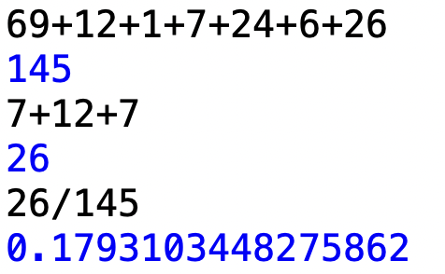
12.3.1 Diabetes data
ghat: prediction diabetes$group: answer
Notes:
MASS 패키지의 lda()함수 사용.

Slide 10
12.3.1 Diabetes data
Visualization!
Notes:
MASS 패키지의 lda()함수 사용.

Slide 11
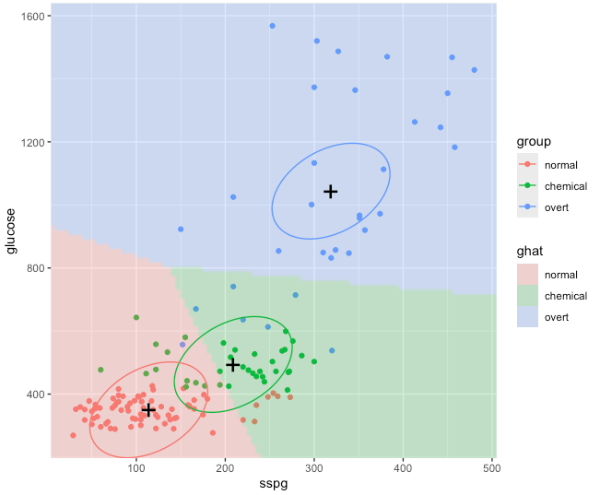
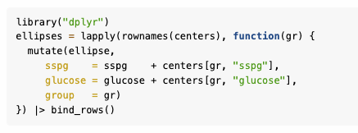
12.3.1 Diabetes data
Visualization!
Notes:
MASS 패키지의 lda()함수 사용.

Slide 12
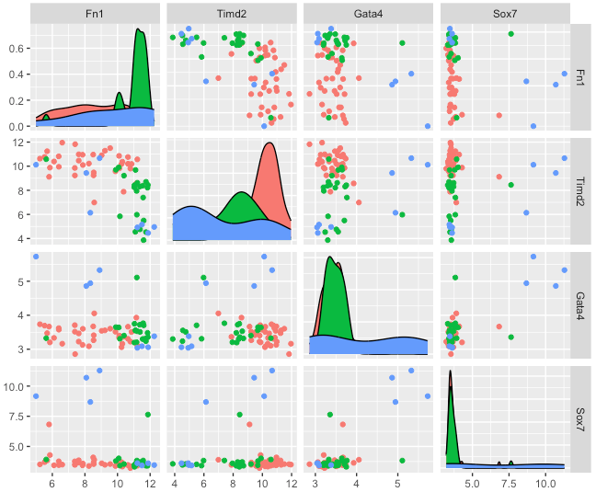
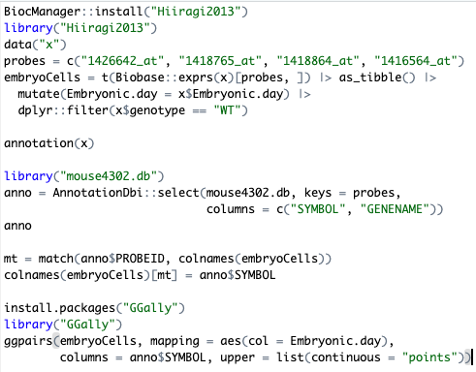
12.3.2 Predicting embryonic cell state from gene expression
Assuming that we already know that the four genes FN1, TIMD2, GATA4, SOX7 are relevant to the classification task, we will build a classifier that predicts the developmental time(embryonic days: E3.25, E3.5, E4.5)

Slide 13
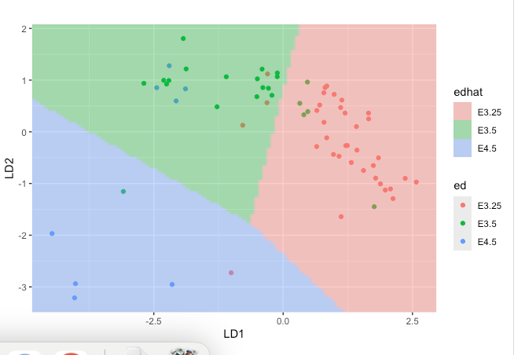
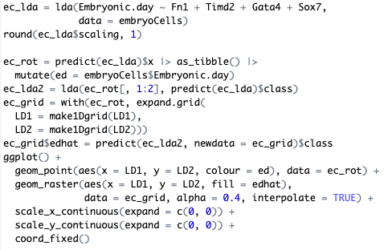
12.3.2 Predicting embryonic cell state from gene expression
To visualize the learned model, we need to build prediction regions and their boundaries by expanding the grid in the space of the two new coordinates LD1 and LD2.

Slide 14
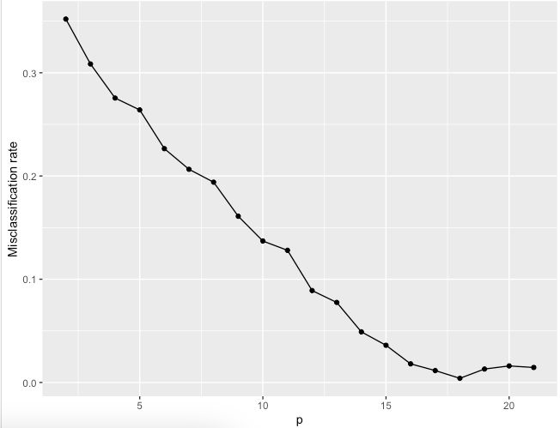
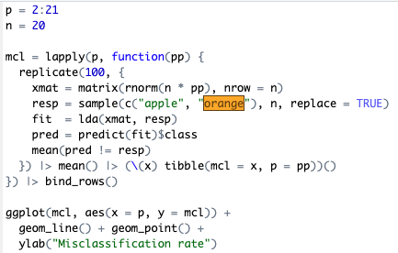
12.4 Machine learning vs rote learning
Generating random data for n objects, with p numbers of features.
Train a LDA on these data and compute the misclassification rate.
ggplot -> misclassification rate & p plot
What’s the problem? -> model performance is evaluated on the same data on which it was trained.

Slide 15
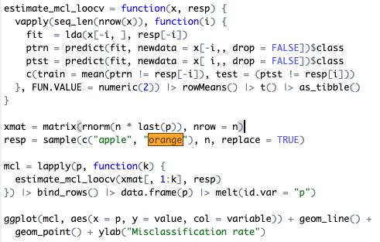
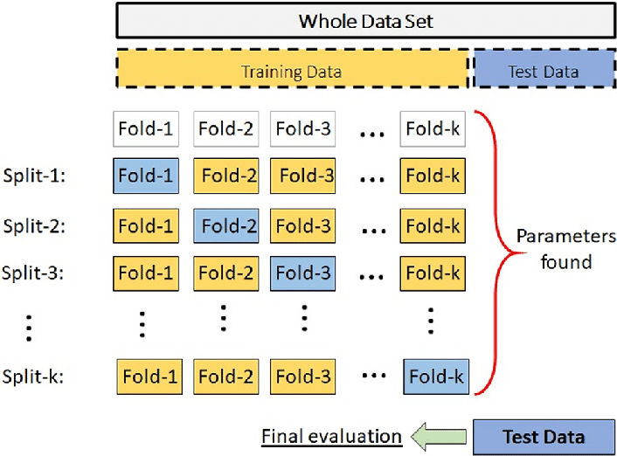
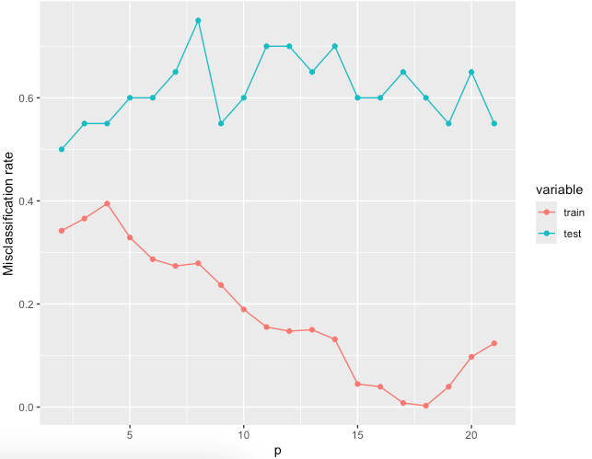
12.4.1 Cross-validation
K-fold cross validation
Sevinç, Ender. "An empowered AdaBoost algorithm implementation: A COVID-19 dataset study." Computers & Industrial Engineering 165 (2022): 107912.

Slide 16
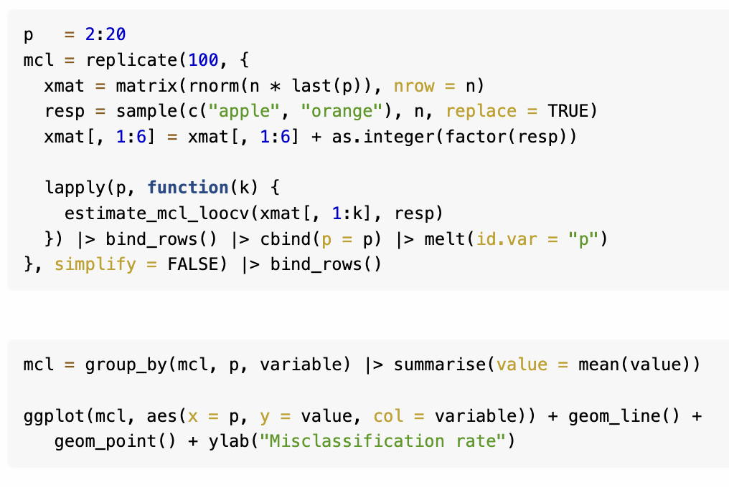
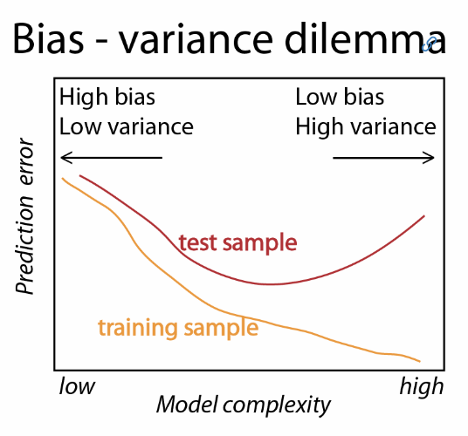
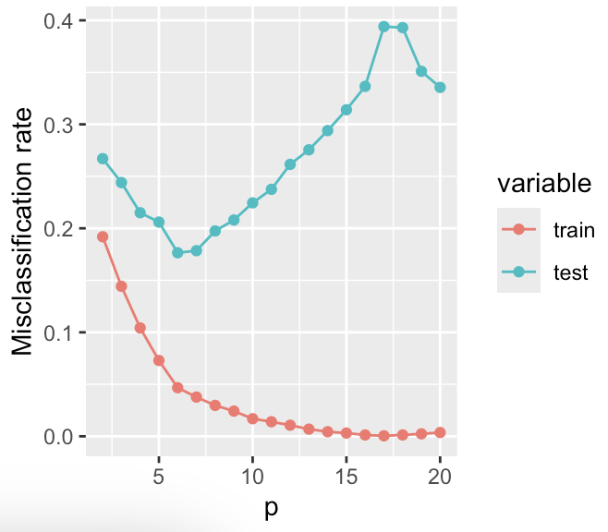
12.4.2 The curse of dimensionality
Notes:
Feature 개수가 줄어들면 당연히 정확도가 낮게 나오고(bias가 커서), feature 개수가 너무 많아도 예측이 잘 안된다.

Slide 17
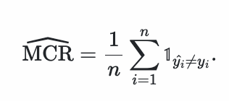
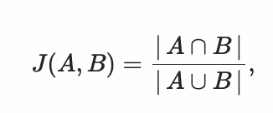
12.5 Objective functions
Misclassification rate(MCR)
Jaccard index
Log loss
Mean squared error

Slide 18
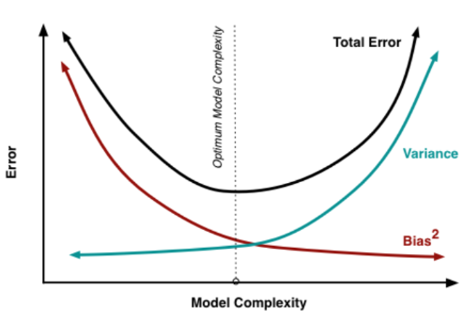
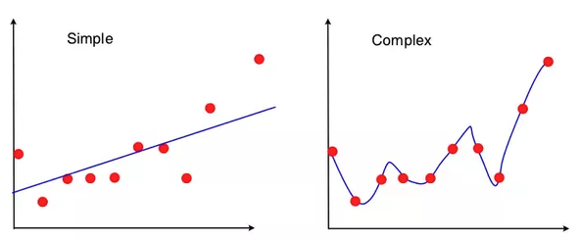
12.6 Variance-bias trade-off
Low variance
High bias
High variance
Low bias

Slide 19
12.6.1 Penalization
High-dimensional statistics -> logistic regression is more general approach than LDA
Controlling variance-bias tradeoff.
Posterior log-odds between k classes
Penalized objective function

Slide 20
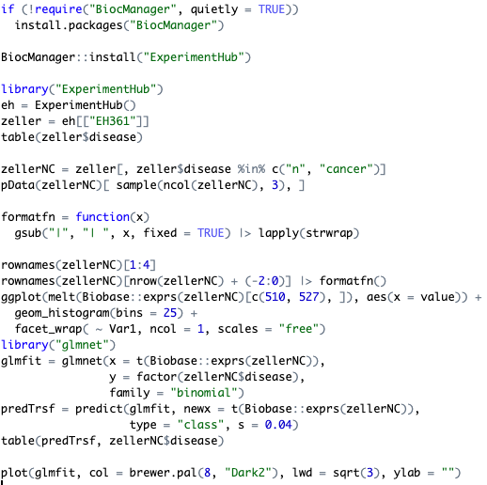
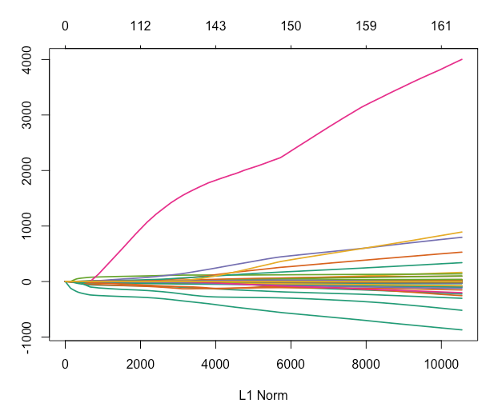
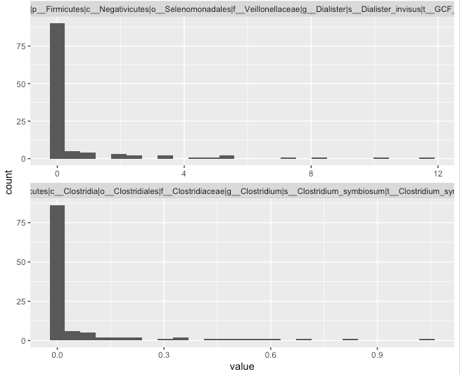
12.6.2 Example: predicting colon cancer from stool microbiome composition

Slide 21
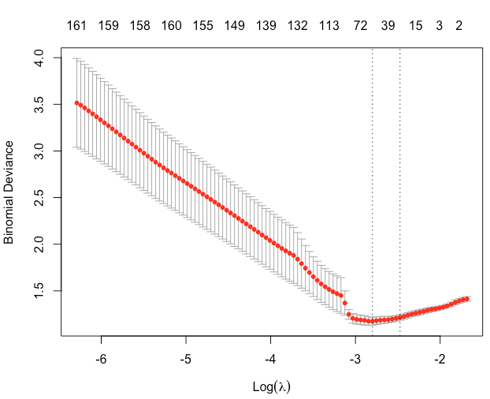
12.6.2 Example: predicting colon cancer from stool microbiome composition
Notes:
Optimizing lambda, vertical lines are min and lse

Slide 22
12.7 A large choice of methods
Other examples of different learning algorithms
Support vector machines – svm in e1071, ksvm in kernlab
Tree based methods – rpart, tree, randomForest
Boosting methods – glmboost and gamboost in mboost
PenalizedLDA in PenalizedLDA
Dudi.discr and dist.pcaiv in ade4

Slide 23
12.8 Summary of this chapter
This chapter focused on predicting categorical variables rather than predicting continuous outcomes.
Linear and quadratic discriminant analysis – methods for partitioning two dimensional data plane into linear/quadratic separation lines
Logistic regression
Main challenge of machine learning: how to avoid overfitting?

